Slide 1


AMERICAN INTERNATIONAL UNIVERSITY–BANGLADESH (AIUB)
FACULTY OF SCIENCE & TECHNOLOGY
DEPARTMENT OF CSE
Summer 2023-2024
Section: C, Group:
Faysal Ahmmed Asef Rahman Antik Md. Mirazul Hasan Most. Sayma Khatun
22-47069-1 22-47106-1 22-46674-1 22-47035-1

Slide 2
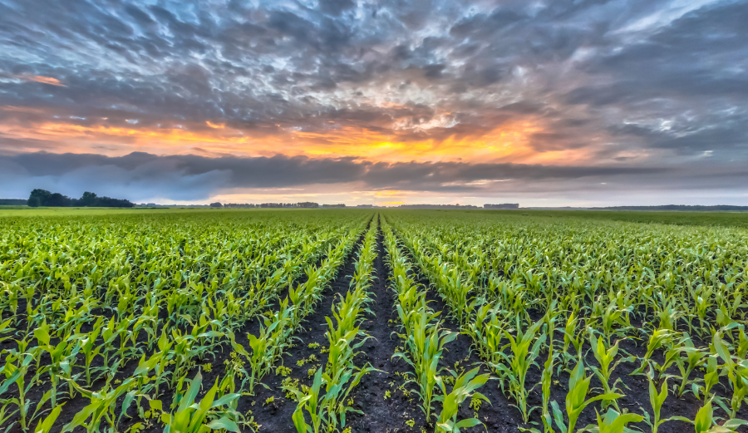
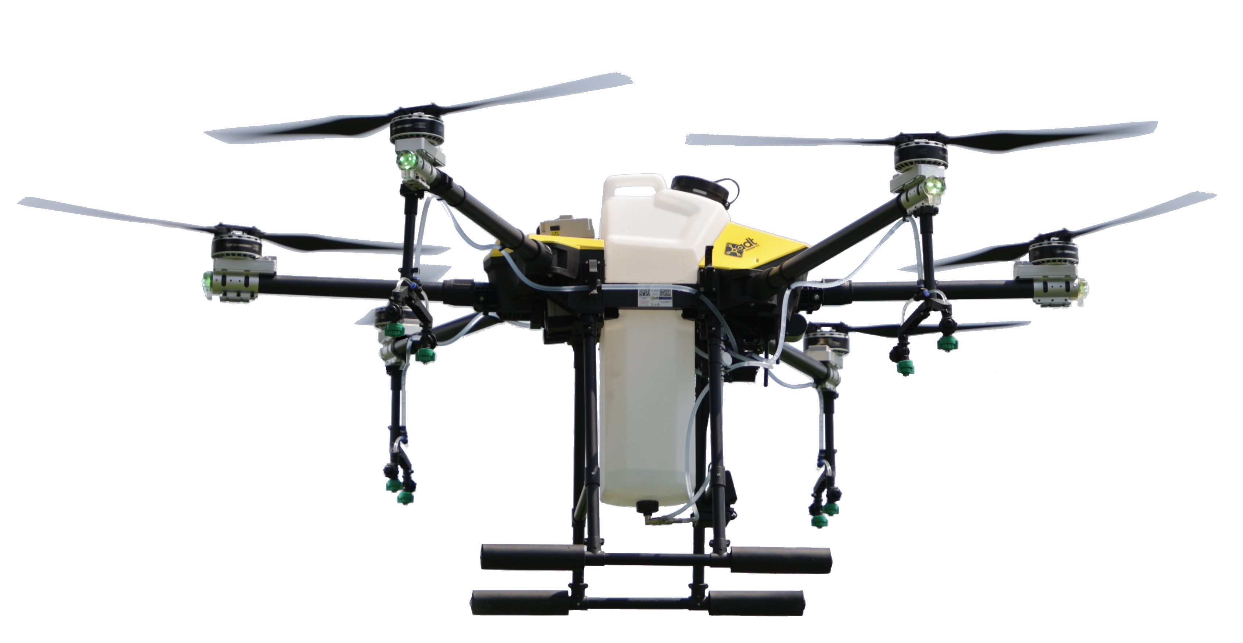
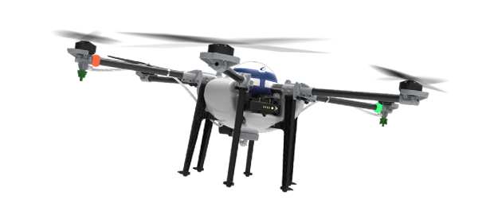

Ways to help small and medium-sized farms adopt pesticide systems using a Drone

Slide 3
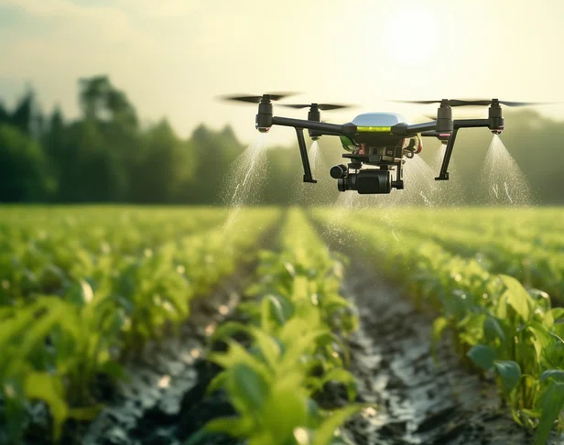
Introduction to Drone
Drones are formally known as unmanned aerial vehicles (UAV), which are essentially flying robots.
They can be controlled by a pilot from the ground or can be autonomous.
Drones used for agricultural purposes are called agriculture drones.
Currently, drones are also used for crop protection, surveillance, traffic monitoring, and weather monitoring.

Slide 4
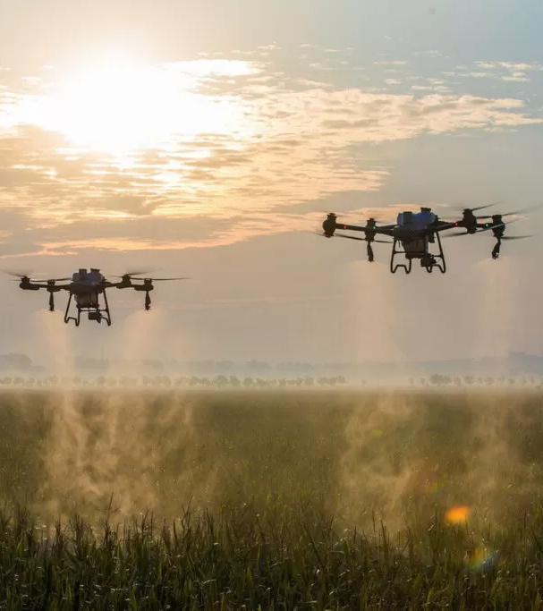
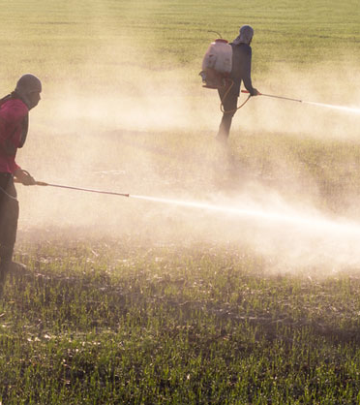
Done Based Pesticide Traditional Pesticide
Aspect | Drone-Based Systems | Traditional Methods
Precision & Accuracy | High precision, reduced waste | Less precise, higher waste
Efficiency | Fast, real-time monitoring | Slow, labor-intensive
Environmental Impact | Minimal contamination | Higher risk of drift/runoff
Cost | High initial cost, long-term savings | Lower initial cost, higher long-term costs
Adoption Barriers | Training, regulations, initial cost | Easier to implement
Technological Integration | Integrates with smart farming tech | Limited integration
VS

Slide 5
Done Based Pesticide Traditional Pesticide
VS
Aspect | Drone-Based Systems | Traditional Methods
Precision & Accuracy | High precision, reduced waste | Less precise, higher waste
Efficiency | Fast, real-time monitoring | Slow, labor-intensive
Environmental Impact | Minimal contamination | Higher risk of pesticide drift or runoff.
Cost | High initial cost, long-term savings | Lower initial cost, higher long-term costs
Adoption Barriers | Training, regulations, initial cost | Easier to implement
Technological Integration | Integrates with smart farming tech | Limited integration

Slide 6
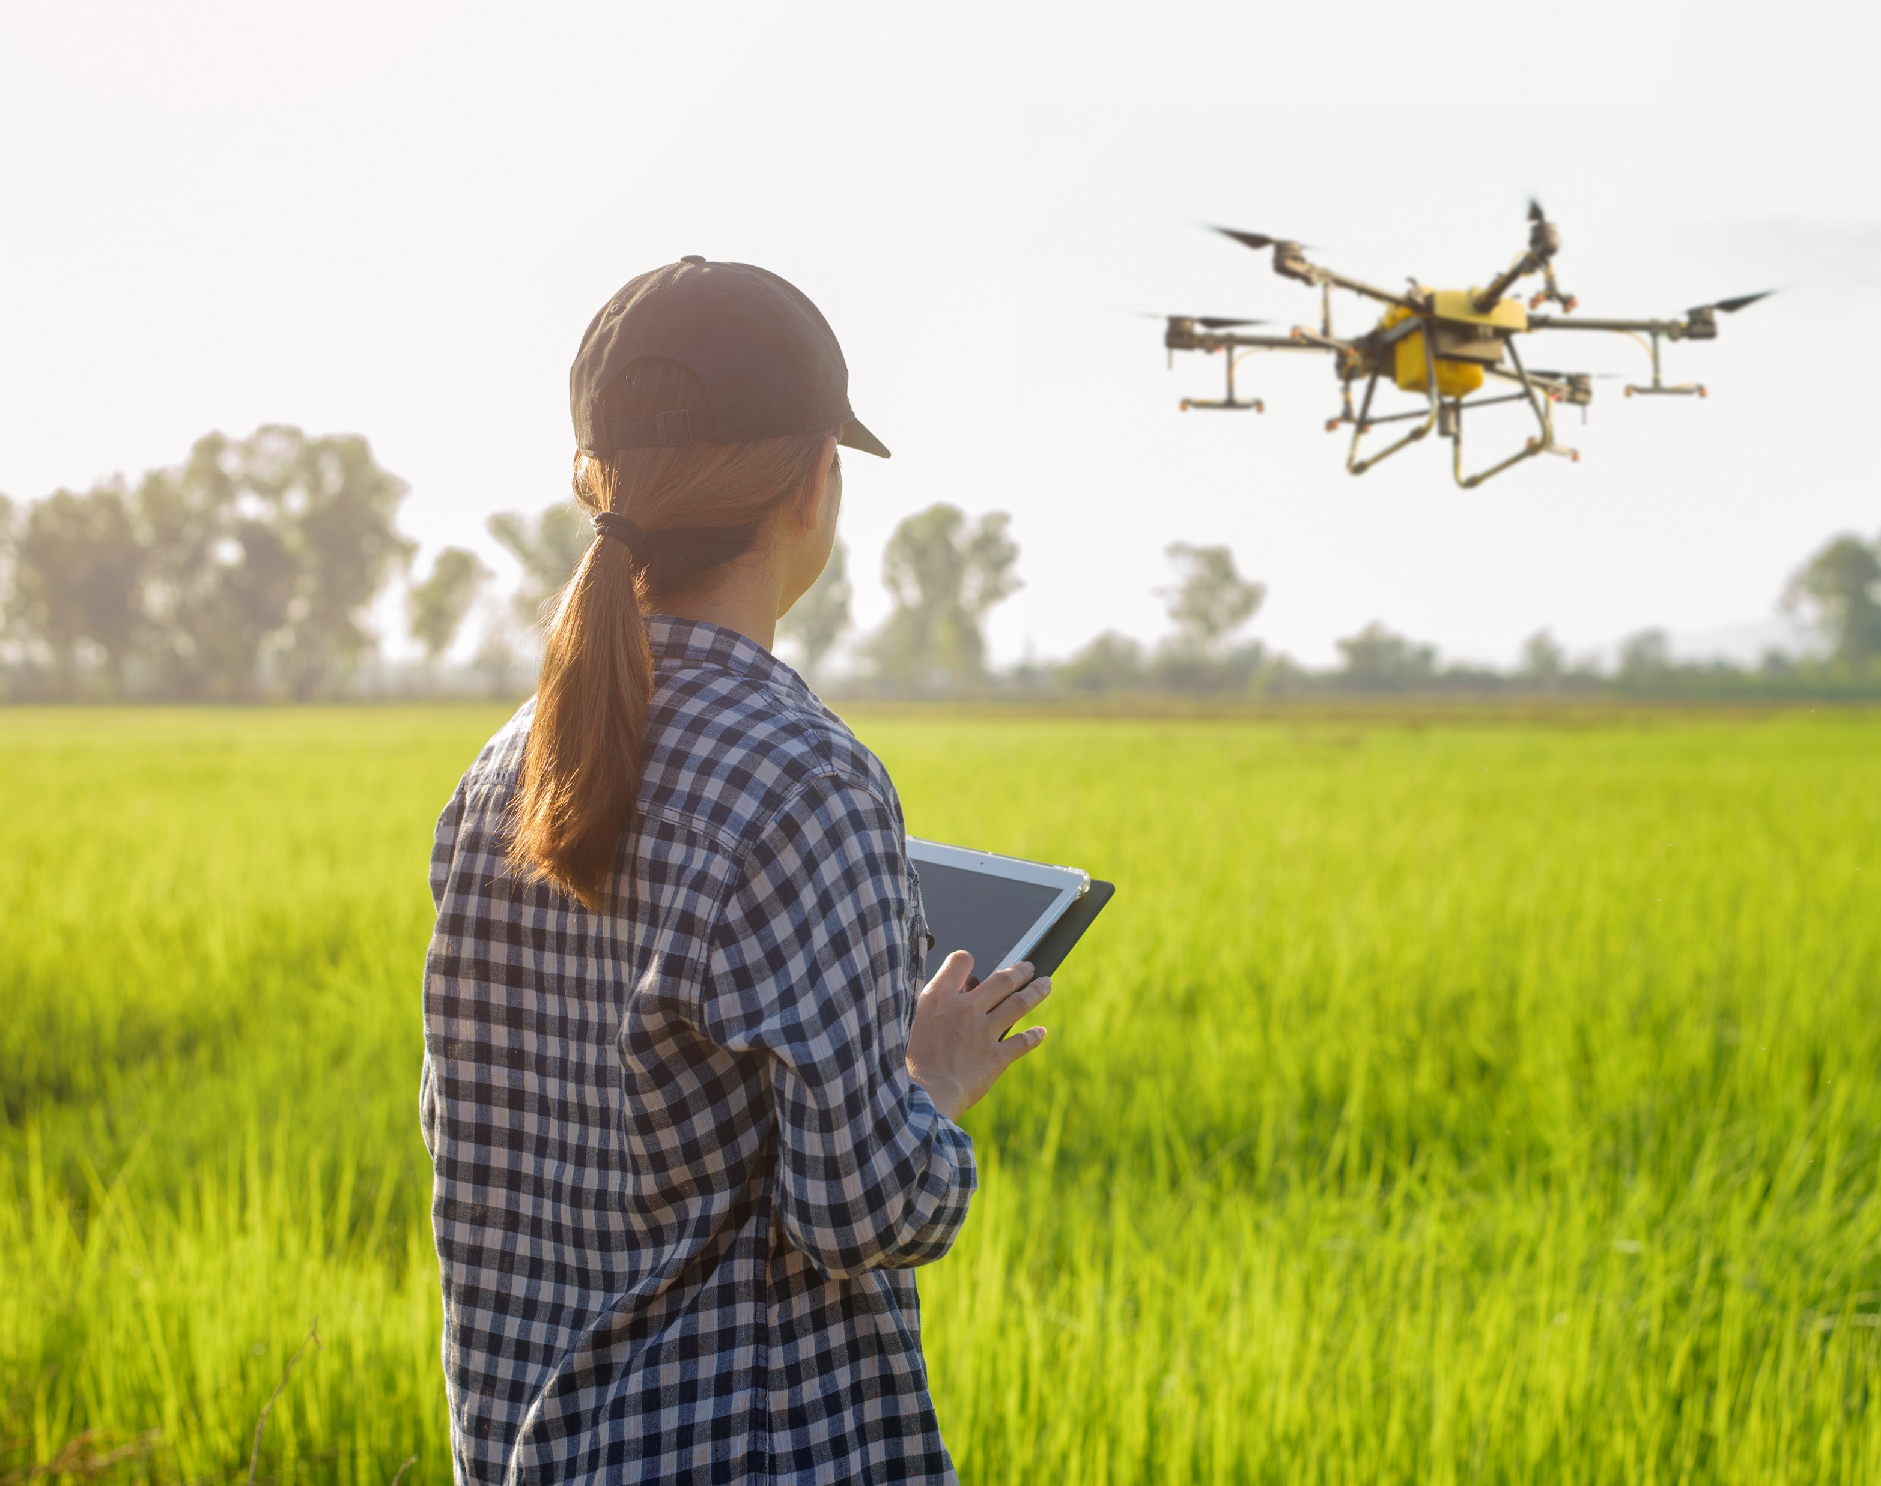
Research Question and Objectives
Primary Research Question
What are some ways to make it easier for small and medium-sized farms to adopt drone-based pesticide systems?
Specific Aims/Objectives
To understand the economic barriers that small to medium-sized farmers face in adopting drone-based pesticide systems.
To describe the challenges associated with the use of UAVs in agriculture and propose potential solutions.
To investigate the effectiveness of training programs in enhancing the skills required for operating drone-based pesticide systems.

Slide 7

Research Type and Research
Method Selection
Research Design: Mixed-Methods
Combines quantitative & qualitative
Comprehensive understanding
Quantitative: statistical data
Qualitative: farmers' perspectives
Ensures reliable results
Research Method: Scientific Method
Systematic approach
Empirical evidence-based
Establish cause-and-effect
Critical analysis

Slide 8
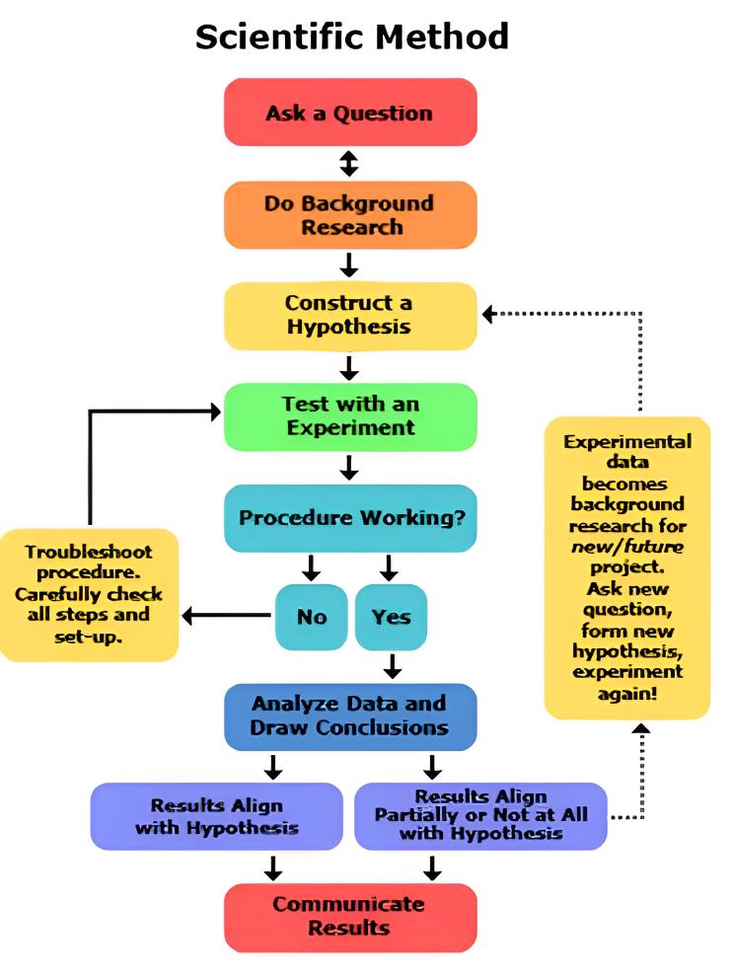
General Steps of
Scientific Method
Figure: Scientific Method for Research Image source: Lecture slides from Research Methodology, Dr. Md. Abdullah - Al - Jubair, AIUB

Slide 9


Scientific Method for researching ways to help small and medium-sized farms adopt pesticide systems using a Drone
2. Background
Research
7. Communicate Results
5. Procedure Working?
3. Construct a Hypothesis
4. Test with an Experiment
6.Analyze Data and Draw Conclusions
1. Ask a Question

Slide 10
Identify current state and challenges in adopting drone-based pesticide systems.
Example Questions:
What are the specific economic barriers faced by small and medium-sized farms?
How do regulatory frameworks impact adoption?
What training programs are available for farmers?
2. Background
Research
7. Communicate Results
5. Procedure Working?
3. Construct a Hypothesis
4. Test with an Experiment
6.Analyze Data and Draw Conclusions
1. Ask a Question
Scientific Method for researching ways to help small and medium-sized farms adopt pesticide systems using a Drone

Slide 11
Use surveys, interviews, and existing data to observe adoption rates, economic conditions, regulatory challenges, and training availability.
Research Activities:
Conduct surveys to gather data on the costs associated with adopting drone technology.
Review existing regulations and their implications on the use of UAVs in agriculture.
Interview farmers to understand their experiences and challenges with existing training programs.
7. Communicate Results
5. Procedure Working?
3. Construct a Hypothesis
2. Background
Research
4. Test with an Experiment
6.Analyze Data and Draw Conclusions
1. Ask a Question
Scientific Method for researching ways to help small and medium-sized farms adopt pesticide systems using a Drone

Slide 12
Hypotheses:
Small and medium-sized farms will adopt drone technology at higher rates if provided with financial incentives.
Simplifying regulatory frameworks will increase the adoption of drone-based pesticide systems.
Comprehensive training programs will enhance farmers' ability to use drone technology effectively.
2. Background
Research
7. Communicate Results
5. Procedure Working?
3. Construct a Hypothesis
4. Test with an Experiment
6.Analyze Data and Draw Conclusions
1. Ask a Question
Scientific Method for researching ways to help small and medium-sized farms adopt pesticide systems using a Drone

Slide 13
Experiment Steps:
Provide financial incentives to a sample group of farms and compare adoption rates with a control group.
Simplify regulatory requirements for another sample group and measure the impact on adoption rates.
Conduct training workshops and assess the improvement in farmers' knowledge and confidence in using drone technology.
2. Background
Research
7. Communicate Results
5. Procedure Working?
3. Construct a Hypothesis
6.Analyze Data and Draw Conclusions
4. Test with an Experiment
1. Ask a Question
Scientific Method for researching ways to help small and medium-sized farms adopt pesticide systems using a Drone

Slide 14
Evaluate whether the interventions are effective in increasing adoption rates and improving operational efficiency.
Evaluation Questions:
Did the financial incentives result in a significant increase in adoption rates?
How did the simplified regulations affect farmers' willingness to adopt drone technology?
Did the training programs lead to measurable improvements in the use of drones for pesticide application?
2. Background
Research
7. Communicate Results
5. Procedure Working?
3. Construct a Hypothesis
6.Analyze Data and Draw Conclusions
4. Test with an Experiment
1. Ask a Question
Scientific Method for researching ways to help small and medium-sized farms adopt pesticide systems using a Drone

Slide 15
Determine the impact of financial incentives, simplified regulations, and training on the adoption rates.
Refine hypotheses based on findings.
Data Analysis:
Compare adoption rates, operational efficiency, and farmer knowledge before and after the interventions.
Look for any connections between the strategies and the results.
Refine hypotheses based on the data analysis, such as exploring additional support mechanisms if financial incentives alone are insufficient.
2. Background
Research
7. Communicate Results
5. Procedure Working?
3. Construct a Hypothesis
4. Test with an Experiment
6.Analyze Data and Draw Conclusions
1. Ask a Question
Scientific Method for researching ways to help small and medium-sized farms adopt pesticide systems using a Drone

Slide 16
Share the findings and validated strategies with the farming community and stakeholders.
Communication Methods:
Publish the research findings in academic journals and industry publications.
Present the results at agricultural conferences and workshops.
Engage with policymakers to recommend regulatory changes and support programs based on the research findings.
2. Background
Research
7. Communicate Results
5. Procedure Working?
3. Construct a Hypothesis
4. Test with an Experiment
6.Analyze Data and Draw Conclusions
1. Ask a Question
Scientific Method for researching ways to help small and medium-sized farms adopt pesticide systems using a Drone

Slide 17
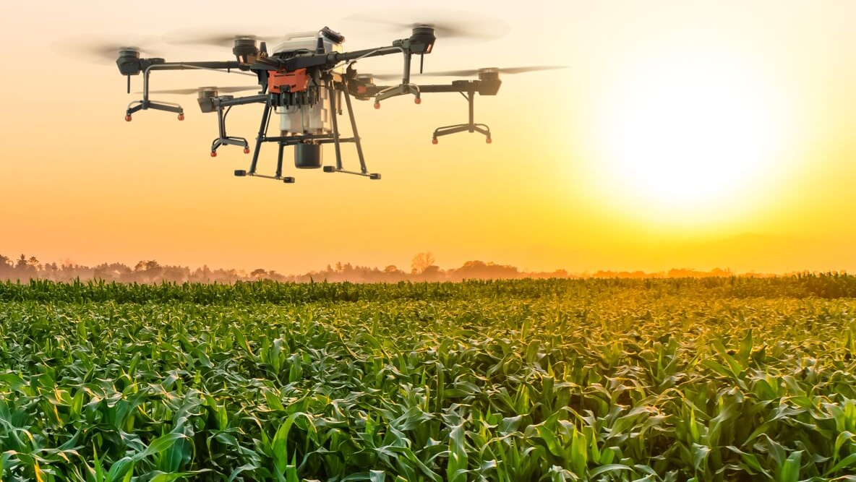
Conclusion
Researching drone-based pesticide systems benefits from the scientific method for precise, replicable results and hypothesis validation through controlled experiments.
The mixed-methods approach integrates quantitative data with qualitative insights to comprehensively address adoption barriers, enhancing decision-making, policies, training, and adoption strategies for sustainable agricultural practices.

Slide 18

Thank you for your patience

